Slide 1
User Experience &
Usability Evaluation
JOUR479D/779D
University of Maryland
Nick Diakopoulos

Slide 2
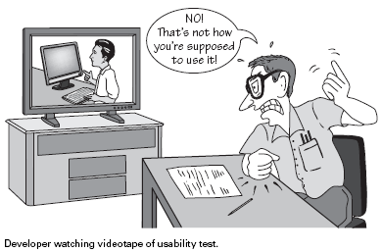
Notes:
As a designer you have in mind certain ways of how your users will experience what you’ve created … but that might not always match reality.

Slide 3
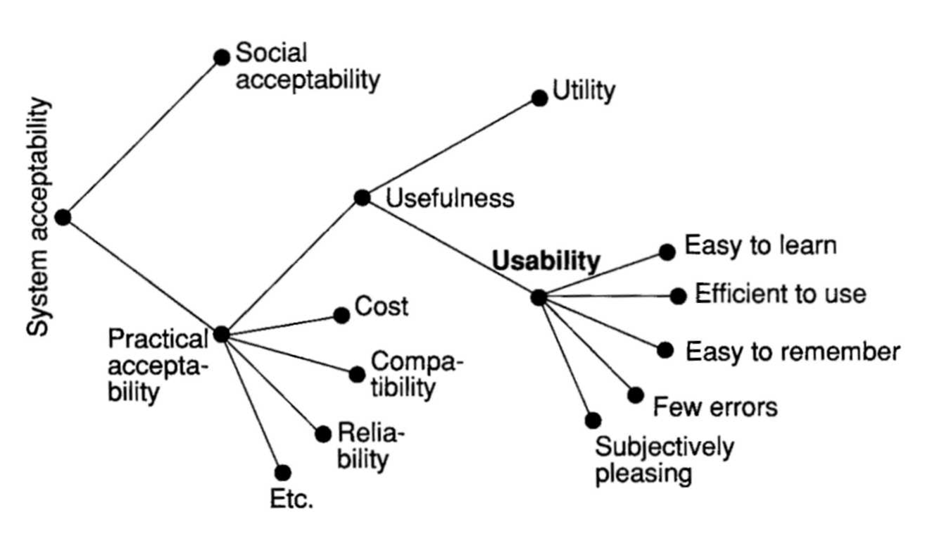
What is Usability?
Notes:
System acceptability is the larger construct of which usability is just one component. SA deals with larger issues like social acceptability, cost, compatability, usefulness
Important question to ask is: “Who are users?”
This is the traditional view of usability. But sometimes usability is different for different artifacts, like play items or games.

Slide 4
Dimensions of Usability
Learnability
Should be easy to learn, but appropriate to task
Efficiency
Once learned should lead to high productivity
Memorability
Easy to remember commands, info in interface
Errors
Low error rate, good error recovery
Satisfaction
Pleasant and subjectivity satisfying

Slide 5
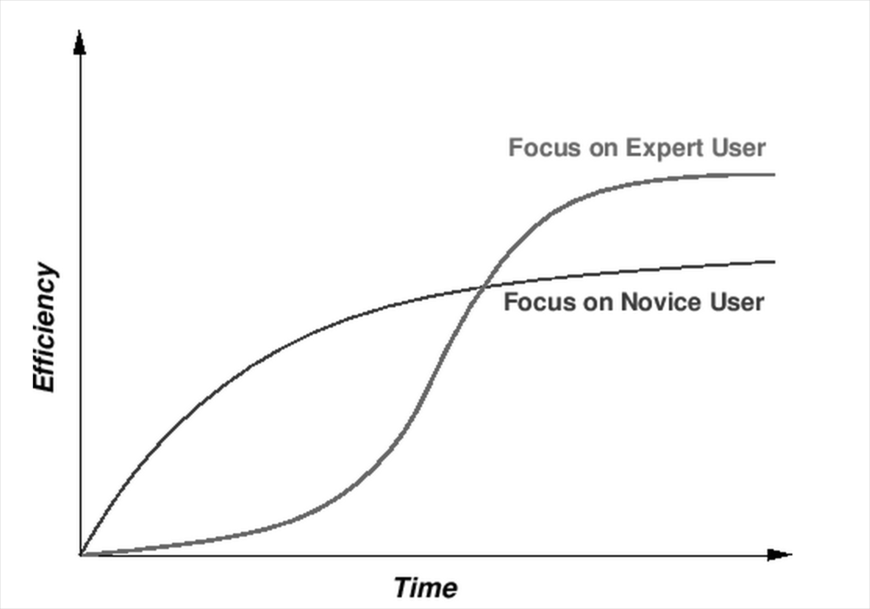
Learnability
Appeal to novices or experts?
Help systems, tacit tutorials
Notes:
People don’t usually take the time to fully learn the system, then you need to have a good help availble.
Graph: focusing on a novice users helps them be efficient and productive earlier, but they might plateau, whereas focusing on expert users takes longer to get going, but once they get the hang of it it’s a lot more powerful. Just consider something like Excel spreadsheets and charts vs. Tableau. One is a lot easier to learn, but the other is much more powerful.

Slide 6
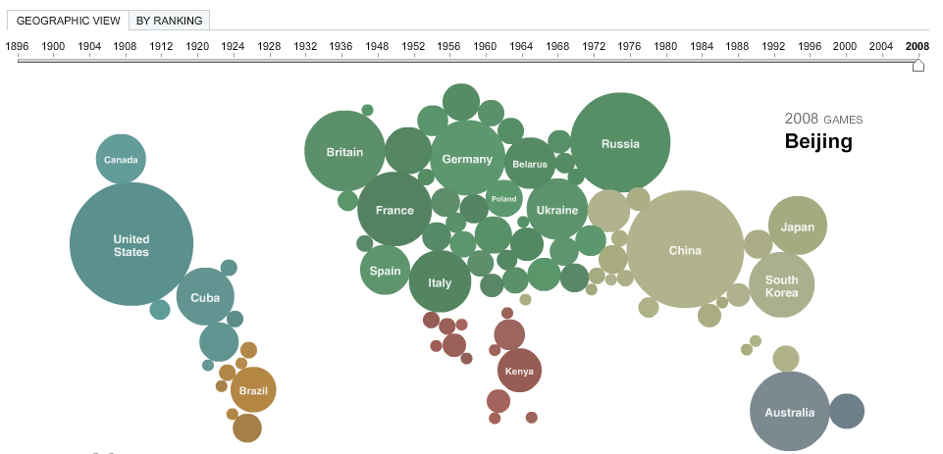
Tacit Tutorial
Notes:
http://www.nytimes.com/interactive/2008/08/04/sports/olympics/20080804_MEDALCOUNT_MAP.html?_r=0
Auto animates when you load to show you that you can update the slider to update the year.

Slide 7
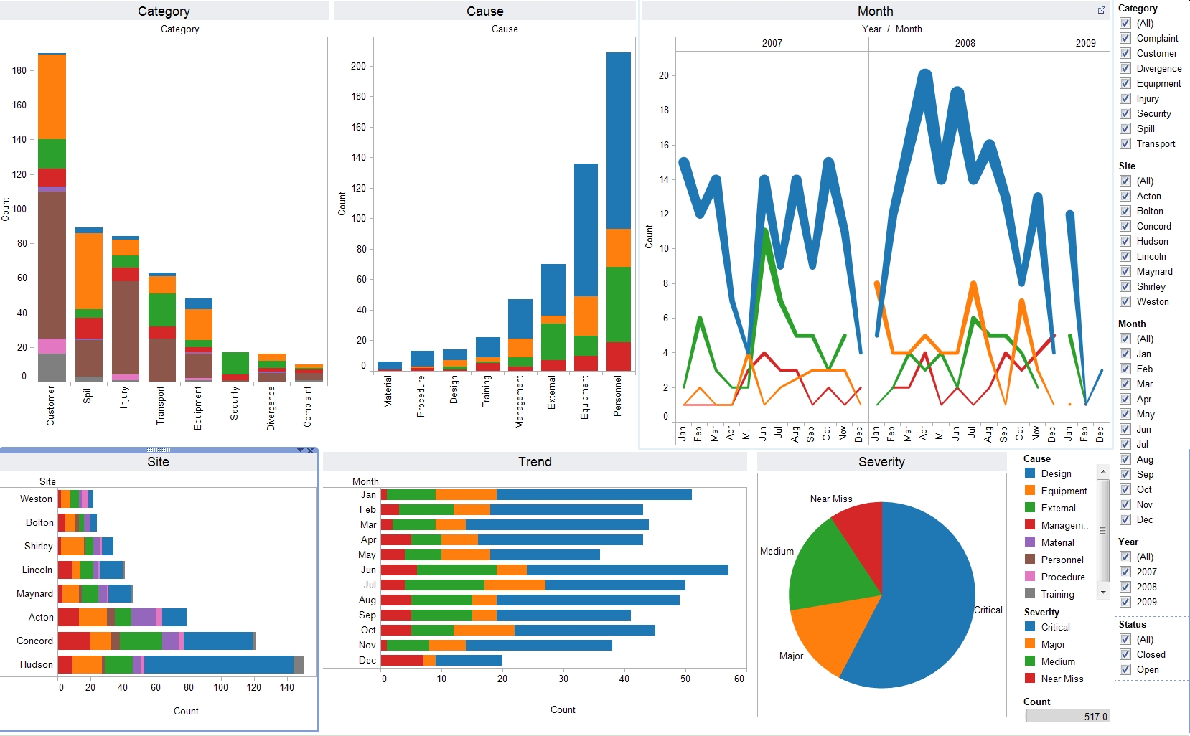
Efficiency
Rate of performance using software, once learned
Notes:
Efficiency hinges on a very close understanding of actual tasks and how experts perform them.

Slide 8
Errors
An action that does not accomplish the desired goal of user or yields an unintended result
Slips: action not as intended (action / execution error)
e.g. hit save instead of “save as” on menu. “Ooops!”
Mistakes: intention inappropriate (intention error)
e.g. initiate a context menu for a command that’s not there
Recoverability
Forward error recovery (correct error)
Backward error recovery (undo error)
Notes:
Slips: action, attention
Mistakes: perception
How likely is your design to allow people to make mistakes? Does it allow them to recover gracefully?

Slide 9
Satisfaction
How pleasant was the experience?
Enjoyability / Fun
Subjective measures
Ask the user for opinion – questionnaire
Frustration / difficulties?
Easy to accomplish what you wanted?
Pleasant to work with?
Would you recommend to friends or others?
Do you prefer system A or system B?

Slide 10
Accessibility / Universal Design
Design to be usable by as many people as possible, in as many situations as possible
Perceptibility
Dual encodings (e.g. ALT tags on images), support different output types (e.g. screen readers)
Simplicity
Reading level, domain experience / knowledge, concentration level
Notes:
Visual / auditory impariments → perceptibility important
This is undreexplored in vis – how do you provide an accessible version to people with visual impairments?

Slide 11
Evaluating Usability
User Testing
Laboratory studies, field studies
Some early beats lots late
Discount Usability Testing
Heuristic evaluation, Think-aloud studies
Other methods
Interviews
Surveys
Interaction logs, analytics
Screen-recording & observation
Eyetracking
Notes:
Interviews: don’t lead the user, ask open-ended questions, be sure to run a pilot
Surveys: useful for measuing user satisfaction, how will you recruit – opt in or random sample?
Interaction logs

Slide 12
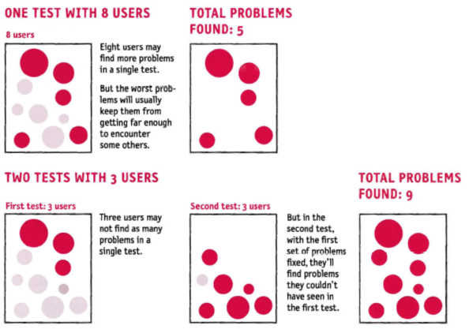
Iterative Testing

Slide 13
Planning a User Study
Choose tasks / scenarios
Need to define representative tasks, be explicit
Scenarios: set the stage, imagine a context for user
Write protocol
Sequence of steps for administering test; where, when, how long
Recruiting
Try for representative users, but ok to grab anyone within reason
Screening surveys
Compensation
Piloting
Test instructions, question wording, timing
Notes:
Tasks: should be fairly explicit
Scenarios: set up a usage context … imagine that
Recruiting: novices and experts for different kinds of tests: example iPhone testing

Slide 14
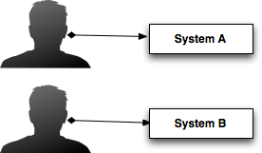
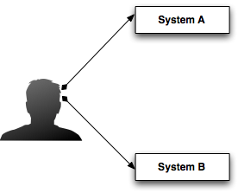
Types of Studies
Between-subject
Different users for each system
Need more participants b/c of individual variation
Within-subject
Same user sees both
Controls for individual variation
Potential learning effects
Balancing order

Slide 15
Reactivity (Expectation Effects)
Perceptions and behavior change as a result of personal expectations or expectations of others
Demand characteristics
People provide responds that they believe are expected by the experimenter or interviewer
Be Careful
“Leading the witness”
Interacting with people in studies
Writing questions for surveys (remember also framing)
Notes:
Hawthorne effect: people modify behavior just because they know they are being studied.

Slide 16
Ethics in User Studies
Beneficence
Act in best interest of participants
Assess risks to participants and try to provide benefit
Compensation
Autonomy
Participant has right to end at any time with no penalty
Privacy / Confidentiality
Especially of recordings
IRB
Institutional Review Board

Slide 17
Discount Usability Methods
Think-Aloud
Researcher + Participant
Heuristic Evaluation
Expert Analysis
Help find usability problems, still up to designer to fix them and re-assess
Notes:
Think aloud is the more expensive in time or money b/c it relies on external people
Ok, so how do we do usability testing on the cheap?

Slide 18
Think-Aloud
Method
Participants use interface and talk as they go
People should be new to interface; from target user group
Concrete tasks or scenarios help focus activity and feedback
Researcher observes / notes difficulties; short interview
Learning, mental model, expectations, desires, satisfaction
Pros
Feedback from real people
Cons
Verbalization slows people down and can change problem solving process
time intensive; must recruit participants; must keep feedback in perspective for low N (e.g. new feature requests); need full prototype;
Notes:
Best if tasks / scenarios can be driven by users in terms of content interests. E.g. if testing your video player that you designed you might want people to be able to play with the interface with content that they liked or were interested in.

Slide 19
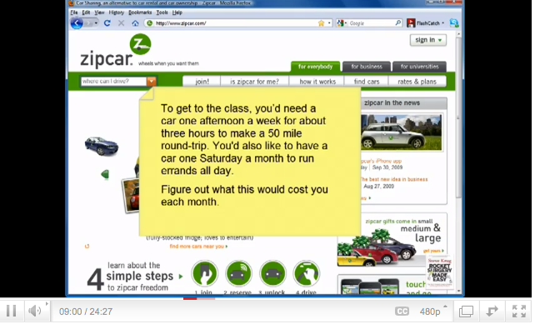
Think Aloud Example
http://www.youtube.com/watch?feature=player_embedded&v=QckIzHC99Xc#!
Notes:
http://www.youtube.com/watch?feature=player_embedded&v=QckIzHC99Xc#!
Start at 0:50, then skip to about 6:15, then 8:15

Slide 20
Heuristic Analysis
Method
Structured critique by multiple independent experts
Standard heuristics + domain specific heuristics
Each expert reports heuristic violations and severity
Pros
Can be used with early design specifications; relatively cheap and fast
Cons
Results depend on “experts”
Notes:
3-5 experts usually enough, 5 results in about 75% of usability problems being discovered

Slide 21
Nielson’s Heuristics
Visibility of system status
Keep users informed about what is going on through appropriate feedback in reasonable time
Match between system and world
Use familiar words, phrases and concepts; follow real-world conventions
User control and freedom
Support undo and redo; allow for “emergency exit”
Consistency and standards
Follow platform and genre conventions and standard
Error prevention
Make it difficult to make errors
Jakob Nielson. Usability Engineering. 1993.

Slide 22
Nielson’s Heuristics
Recognition rather than recall
Make objects, actions, options visible; don’t required memory work; make instructions visible or easily retrieved
Flexibility and efficiency
Allow for tailoring frequent actions
Aesthetic and minimal
Don’t include info that is irrelevant or rarely needed
Help users recognize, diagnose, recover from errors
Any error messages should be in plain language
Help and documentation
Make it easy to search, focused on user tasks, list concrete steps, don’t overwhelm

Slide 23
Shneiderman’s 8 Golden Rules of UI Design
Strive for consistency
Consistent sequences of actions should be required in similar situations; identical terminology should be used in prompts, menus, and help screens; and consistent commands should be employed throughout.
Enable frequent users to use shortcuts
As the frequency of use increases, so do the user's desires to reduce the number of interactions and to increase the pace of interaction. Abbreviations, function keys, hidden commands, and macro facilities are very helpful to an expert user.
Offer informative feedback
For every operator action, there should be some system feedback. For frequent and minor actions, the response can be modest, while for infrequent and major actions, the response should be more substantial.
Design dialog to yield closure
Sequences of actions should be organized into groups with a beginning, middle, and end. The informative feedback at the completion of a group of actions gives the operators the satisfaction of accomplishment, a sense of relief, the signal to drop contingency plans and options from their minds, and an indication that the way is clear to prepare for the next group of actions.
Shneiderman et al. Designing the User Interface.

Slide 24
Shneiderman’s 8 Golden Rules of UI Design
Offer simple error handling
As much as possible, design the system so the user cannot make a serious error. If an error is made, the system should be able to detect the error and offer simple, comprehensible mechanisms for handling the error.
Permit easy reversal of actions
This feature relieves anxiety, since the user knows that errors can be undone; it thus encourages exploration of unfamiliar options. The units of reversibility may be a single action, a data entry, or a complete group of actions.
Support internal locus of control
Experienced operators strongly desire the sense that they are in charge of the system and that the system responds to their actions. Design the system to make users the initiators of actions rather than the responders.
Reduce short-term memory load
The limitation of human information processing in short-term memory requires that displays be kept simple, multiple page displays be consolidated, window-motion frequency be reduced, and sufficient training time be allotted for codes, mnemonics, and sequences of actions.
Shneiderman et al. Designing the User Interface.

Slide 25
Visualization Specific Heuristics
Information coding
Mapping of data to visual objects and attributes.
Minimal actions
Reduce workload for common tasks
Flexibility
Number of ways of achieving a given goal
Orientation and help
Spatial Organization
Precision and legibility, efficiency of space usage, distortion of visual elements
Forsell and Johansson. An Heuristic Set for Evaluation in Information Visualization. AVI 2010.

Slide 26
Visualization Specific Heuristics
Consistency
Of design choices in similar contexts
Recognition rather than recall
Memorization shouldn’t be necessary to carry out task
Prompting
Help users know alternatives when several actions are possible
Remove the extraneous
Can extra information be a distraction from data or making comparisons?
Data set reduction
Ability to reduce, abstract data
Notes:
Point out that all of these are not always relevant, but it’s useful to have a list of things to think about that may apply

Slide 27
Severity
Severity
How common?
How easy to overcome? (“Kayak” problem?)
One-off or persistent problem? Global?
How seriously will it be perceived?
Severity Rating Scale (0-4)
0 = I don’t agree that this is a usability problem
1 = Cosmetic problem (not necessary to fix)
2 = Minor usability problem
3 = Major usability problem (fix with high priority)
4 = Catastrophic (don’t bother publishing until fixed)
Notes:
Notion of a “kayak” problem that people

Slide 28
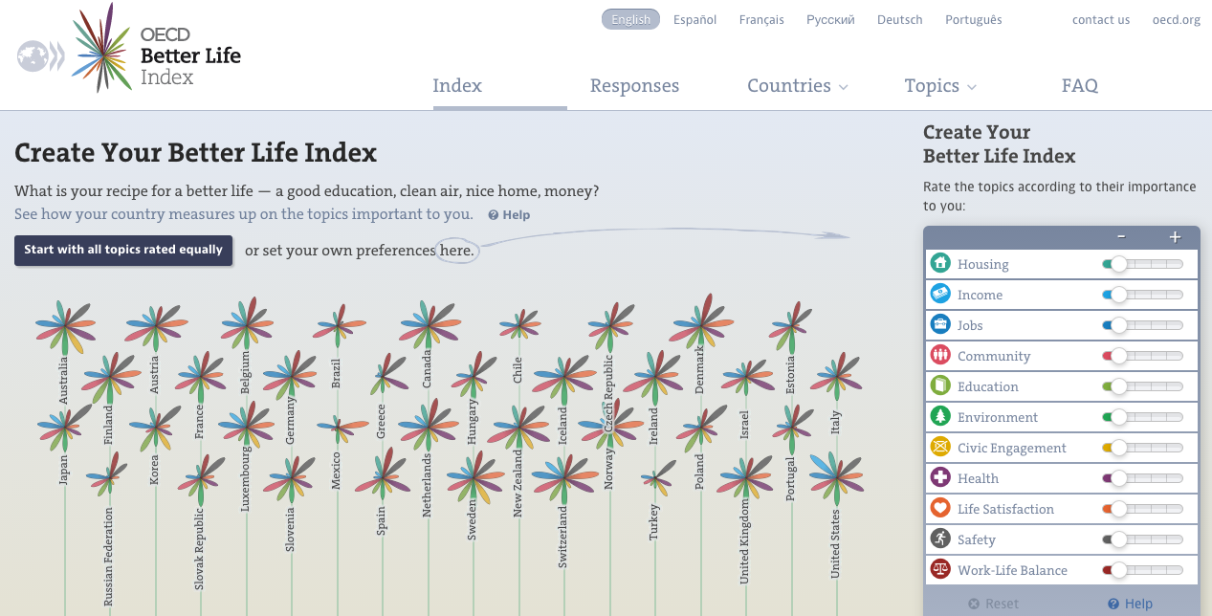
Think Aloud
http://www.oecdbetterlifeindex.org/
In pairs, each take a turn being the user and the evaluator
Find countries with best “economic” indicators
Find countries with greatest / lest gender disparities
Compare the responses of the US with another country
Notes:
Choose a different task for each user.

Slide 29

Heuristic Evaluation
http://www.washingtonpost.com/wp-srv/special/local/dc-recovered-guns/
Evaluate against various heuristics
Grade severity
Are the things you found with a think aloud different than with a heuristic eval?

Slide 30
Questions?

